Slide 1
Transfer Learning with Convolutional Neural Networks
Vivek Viswanathan
Daniel Serna
Steven Cocke
Kevin Mendonsa

Slide 2
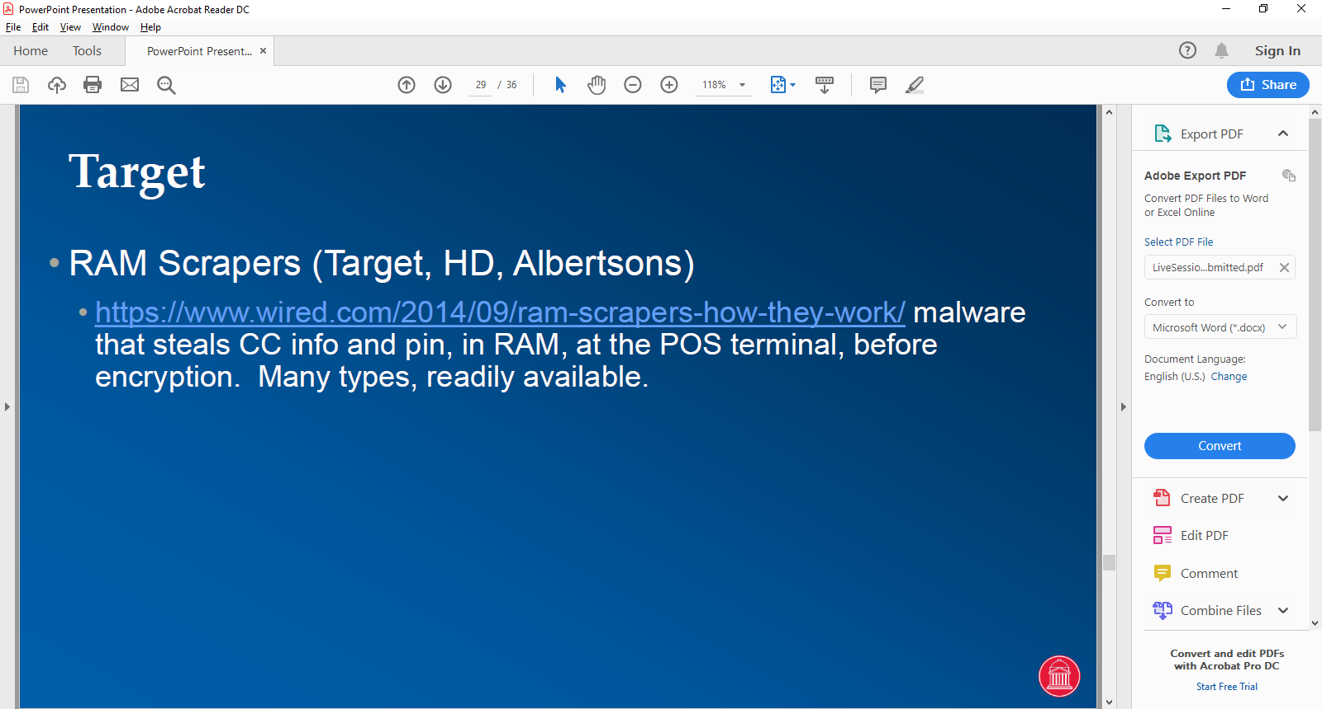
AGENDA
DEEP LEARNING MYTHS
NEURAL NETWORK BRIEF OVERVIEW
CONVOLUTIONAL NEURAL NETWORK BRIEF OVERVIEW
WHAT IS TRANSFER LEARNING WITH CNN
TRANSFER LEARNING: THE CONCEPT
TRANSFER LEARNING: THE PROCESS & STEPS
CONCLUSION
QUESTIONS

Slide 3
Deep Learning Myths
MYTH
One cannot do deep learning unless there are million labeled examples for your specific problem.
TRUTH
One can learn many useful representations from unlabeled data
Learned representations can be transferred from a related task
Train on an adjacent surrogate object which is easy to generate labels

Slide 4
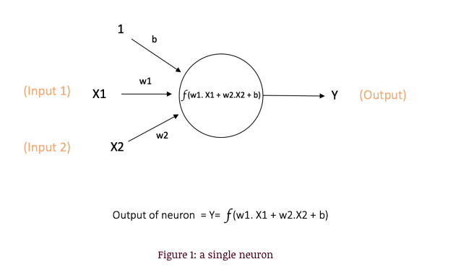
Neural Network Brief Overview
X1, X2 – the inputs
w1,w2 – the weights
b – the bias (also weight)
f – activation function
Y - output

Slide 5
Neural Network Brief Overview
Activation Functions Purpose
To introduce non-linearity into the output of the neuron
Examples include sigmoid, tanh, and ReLU

Slide 6
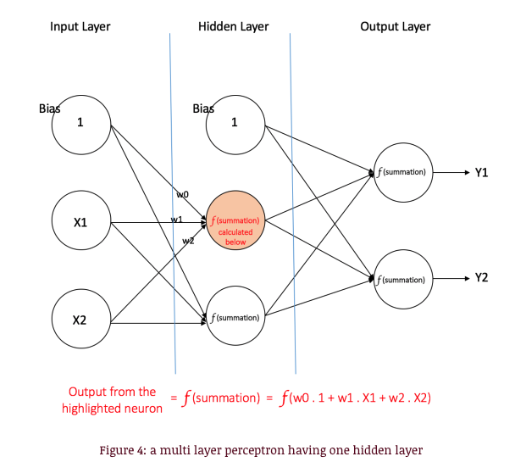
Neural Network Brief Overview
Input nodes: provide information from outside world. No computation.
Hidden nodes: perform computation and transfer information from input nodes to output nodes. Generally 1 more more hidden layers.
Output nodes: more computation and transfer information from network to outside world.

Slide 7
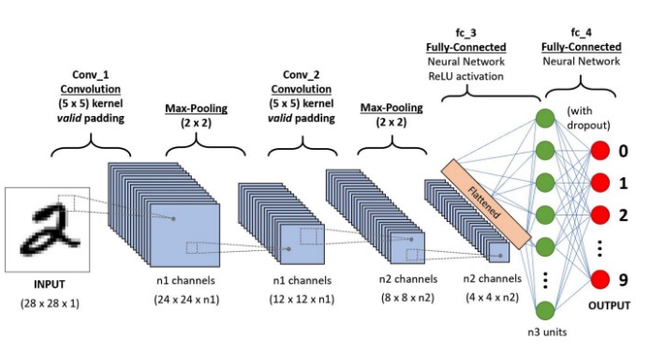
Convolutional Neural Network Brief Overview

Slide 8
Convolutional Neural Network Brief Overview
CNN/ConvNet is a deep learning algorithm which is used to differentiate objects/aspects within an input image via assigning learned weights and biases
The main idea behind CNN is that it reduces the images into forms much easier to process, without losing features which are critical for good prediction

Slide 9
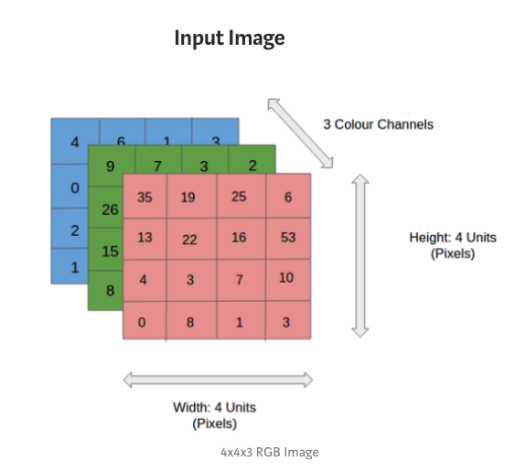
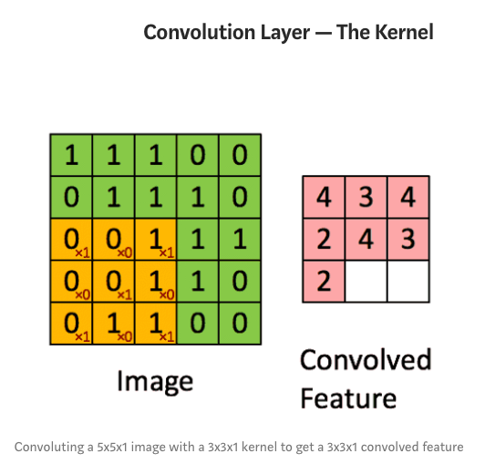
Convolutional Neural Network Brief Overview

Slide 10
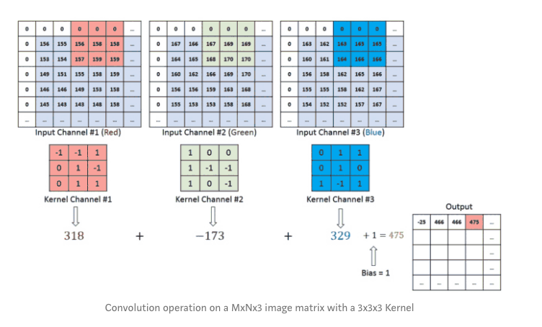
Convolutional Neural Network Brief Overview
The Kernel K is the colored matrix covering a portion of the larger matrices. It traverses the input channel and performs matrix multiplication. The value is then stored in the output of the layer as shown in the bottom right.

Slide 11
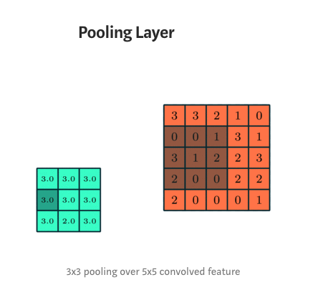
Convolutional Neural Network Brief Overview
Used to reduce the size of the convoluted feature.
Decreases the computational power required.
Examples: max pooling and average pooling

Slide 12
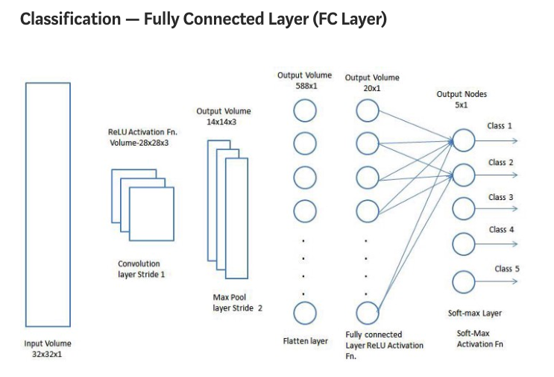
Convolutional Neural Network Brief Overview
Examples of CNNs:
ZFNet
ResNet
GoogLeNet
VGGNet
AlexNet
LeNet

Slide 13
What is Transfer Learning with CNN
Leverage a model trained on a large dataset and transfer its knowledge to a smaller dataset.
Freezing the lower convolutional layers of the network and training just the last few layers that make a prediction when applied to object recognition with CNN.
Based on the principle that the convolutional layers extract more general, low-level features that are applicable across images — such as edges, patterns, gradients, while the higher layers identify more specific features within an image such as eyes, wheels etc.

Slide 14
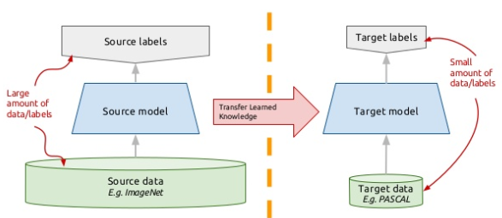
Transfer Learning: The Concept
Instead of training a deep network from scratch for a task:
Adopt a network trained on a different domain for a different source task
Adapt it for your domain and your respective target task
Some Variations:
Same domain, different task
Different domain, same task

Slide 15
Transfer Learning: The Steps
Load in a pre-trained CNN model trained on a large dataset
Freeze parameters (weights) in the model’s lower convolutional layers
Add custom classifier with several layers of trainable parameters to model
Train classifier layers on training data available for task
Fine tune hyper-parameters and unfreeze more layers as needed
This is a widely used and successful approach that is applicable to wide range of domains.
Transfer Learning is a very useful tool and should be first tried when confronted with a new image recognition problem

Slide 16
Data SetUp
Formatting the data correctly will determine the success or failure of the project.
Fortunately, the Caltech 101 dataset images are clean and stored in the correct format.
If we correctly set up the data directories, PyTorch makes it simple to associate the correct labels with each class.
I separated the data into training, validation, and testing sets with a 50%, 25%, 25% split and then structured the directories as follows:

Slide 17
Data Augmentation
The idea of data augmentation is to artificially increase the number of training images our model sees by applying random transformations to the images.
For example, we can randomly rotate or crop the images or flip them horizontally.
We want our model to distinguish the objects regardless of orientation
Data augmentation can also make a model invariant to transformations of the input data.
An elephant is still an elephant no matter which way it’s facing!

Slide 18
Augmentation
Augmentation is generally only done during training (although test time augmentation is possible in the fast.ai library). Each epoch — one iteration through all the training images — a different random transformation is applied to each training image.
This means that if we iterate through the data 20 times, our model will see 20 slightly different versions of each image.
The overall result should be a model that learns the objects themselves and not how they are presented or artifacts in the image.

Slide 19
Image Pre-processing
This is the most important step of working with image data.
During image preprocessing, we simultaneously prepare the images for our network and apply data augmentation to the training set.
Each model will have different input requirements, but if we read through what Imagenet requires, we figure out that our images need to be 224x224 and normalized to a range.

Slide 20
For this implementation, we’ll be using the VGG-16. Although it didn’t record the lowest error, we found it worked well for the task and was quicker to train than other models. The process to use a pre-trained model is well-established:
Load in pre-trained weights from a network trained on a large dataset
Freeze all the weights in the lower (convolutional) layers: the layers to freeze are adjusted depending on similarity of new task to original dataset
Replace the upper layers of the network with a custom classifier: the number of outputs must be set equal to the number of classes
Train only the custom classifier layers for the task thereby optimizing the model for smaller dataset

Slide 21
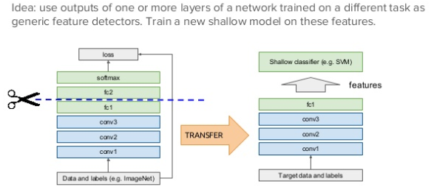
Off the Shelf

Slide 22
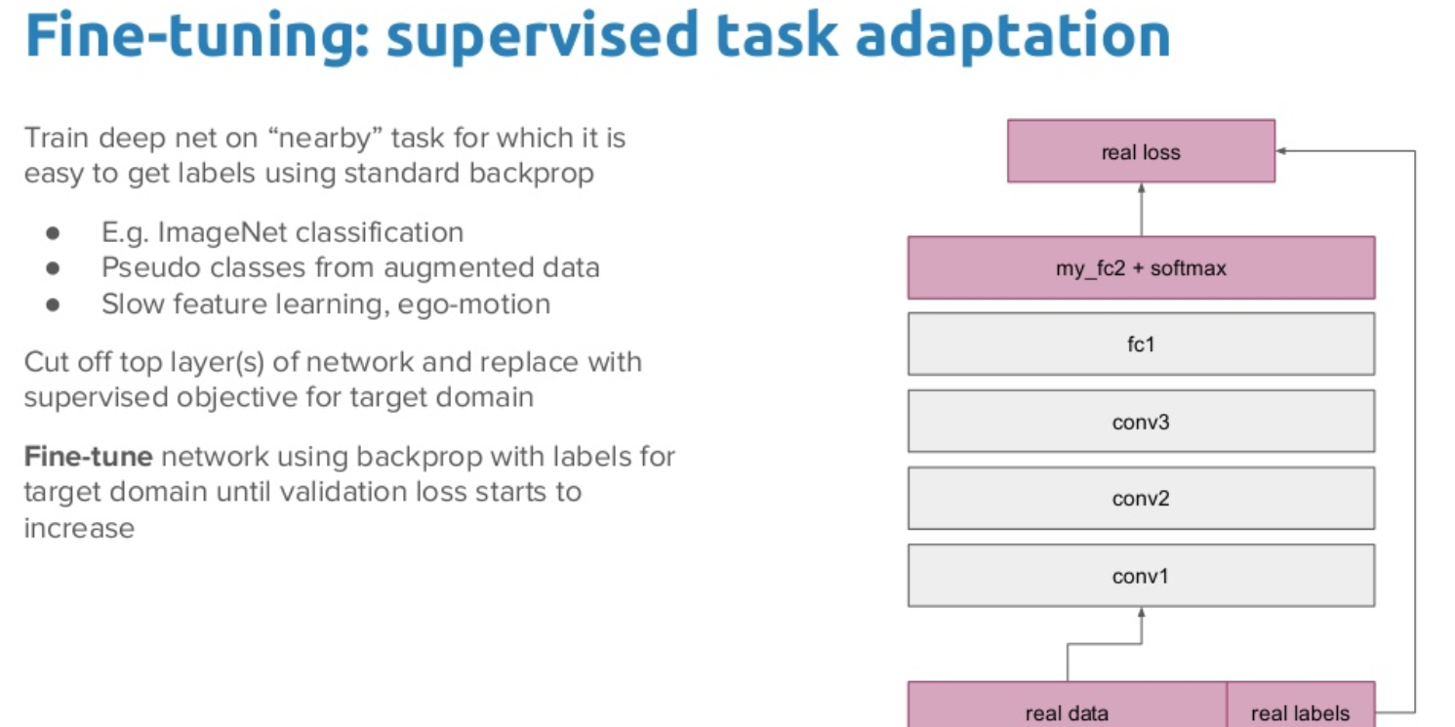

Slide 23
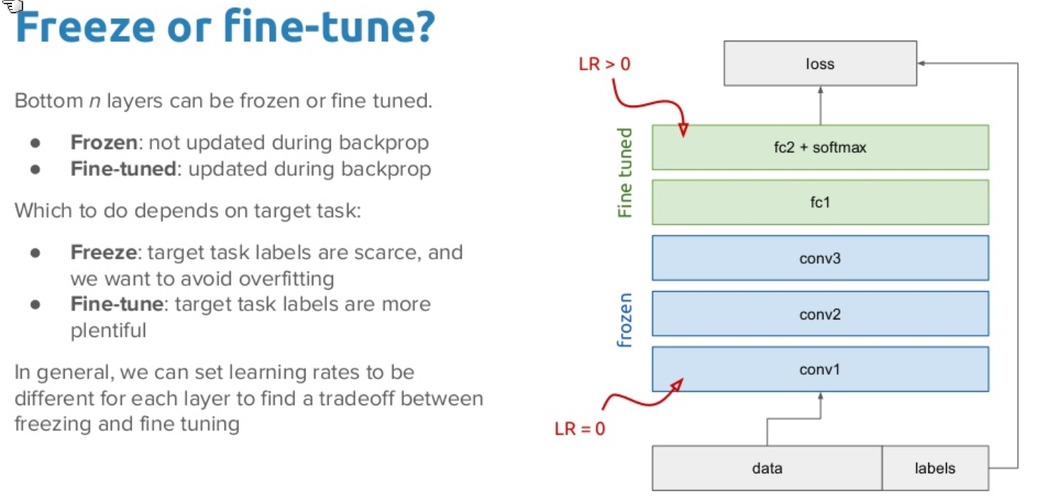

Slide 24
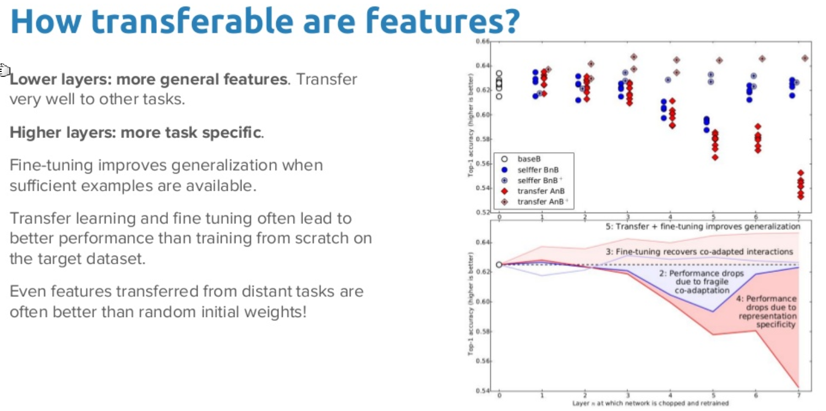

Slide 25
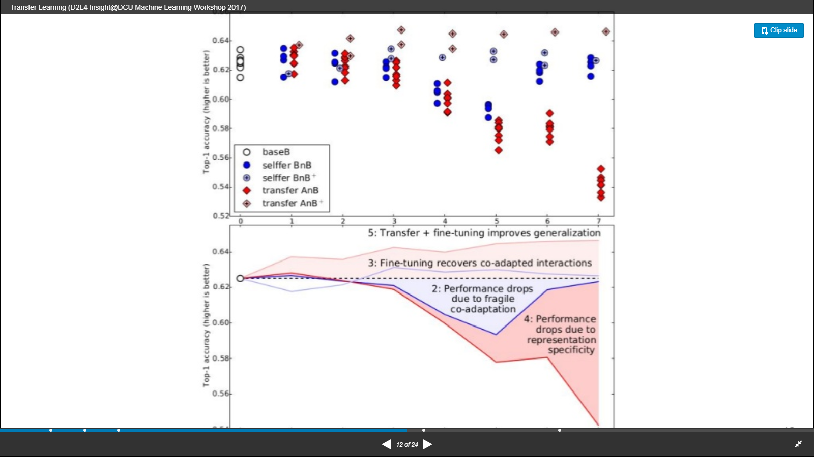

Slide 26
Benefits of Transfer Learning
Can use a network trained on unrelated categories in a massive dataset and apply it to our own model i.e. Imagenet
There are low-level features that are universally shared between images. i.e. the images in the Caltech 101 dataset are very similar to those in the Imagenet dataset. The knowledge a model learns on Imagenet are easily transferable to this task.
Save resources – time and costs
http://www.image-net.org/

Slide 27
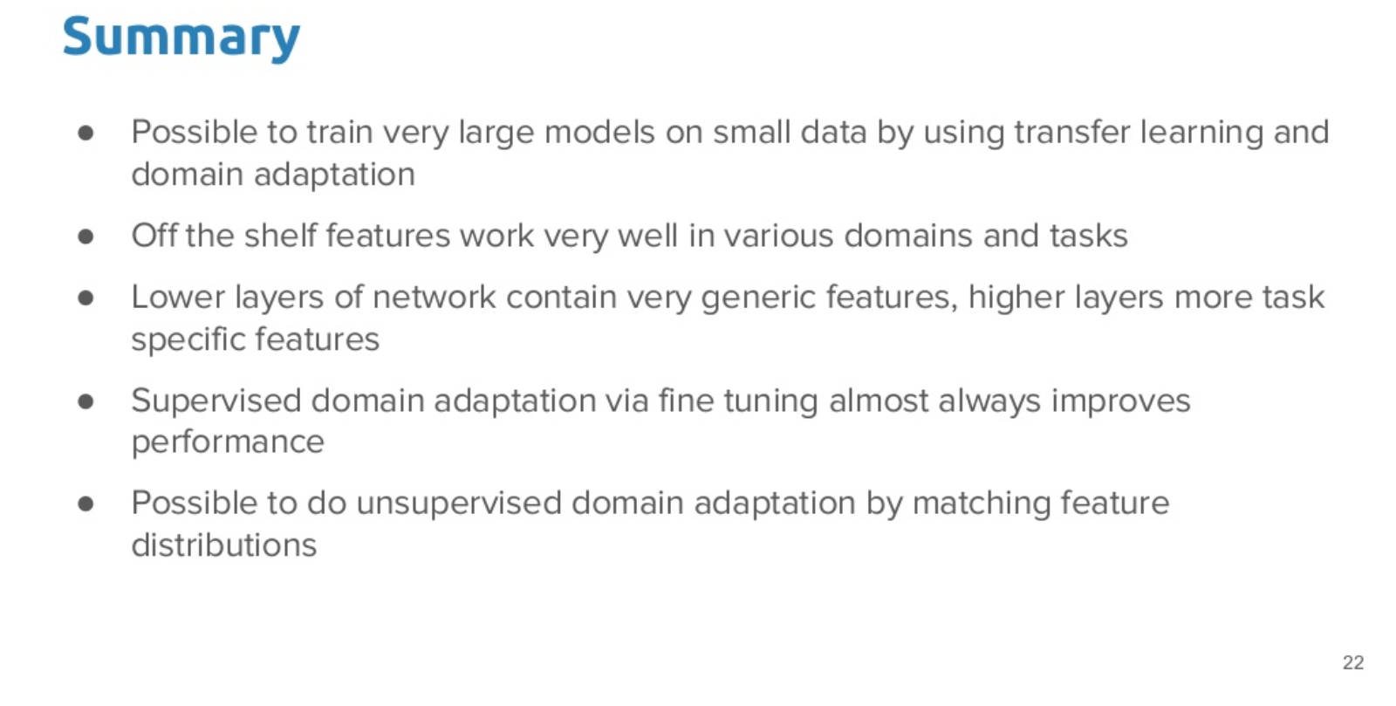

Slide 28
REFERENCES
https://www.slideshare.net/xavigiro/transfer-learning-d2l4-insightdcu-machine-learning-workshop-2017
https://arxiv.org/abs/1411.1792
https://ujjwalkarn.me/2016/08/09/quick-intro-neural-networks/
https://towardsdatascience.com/a-comprehensive-guide-to-convolutional-neural-networks-the-eli5-war-3bd2b1164a53

Slide 29


